Slide 1

MS Excel
Advance Course

Slide 2
Course Objectives
Be able to learn the phases of processing data and different features involved in each phase.
01
Be able to learn how to use Excel Macro, and an overview of VBA coding
02
Be able to learn and apply advanced analytical features in Excel.
03
Be able to learn and apply different visualization to present data.
04

Slide 3

Your Facilitator
Franco Angelo Cipriano
Founder Cocotech Solutions
Bachelor and Masters Degree in IT
Have been using MS Tools since 2008
Have been training MS Excel since 2016
First Skill
Second Skill

Slide 4

Quick Refresher

Slide 5
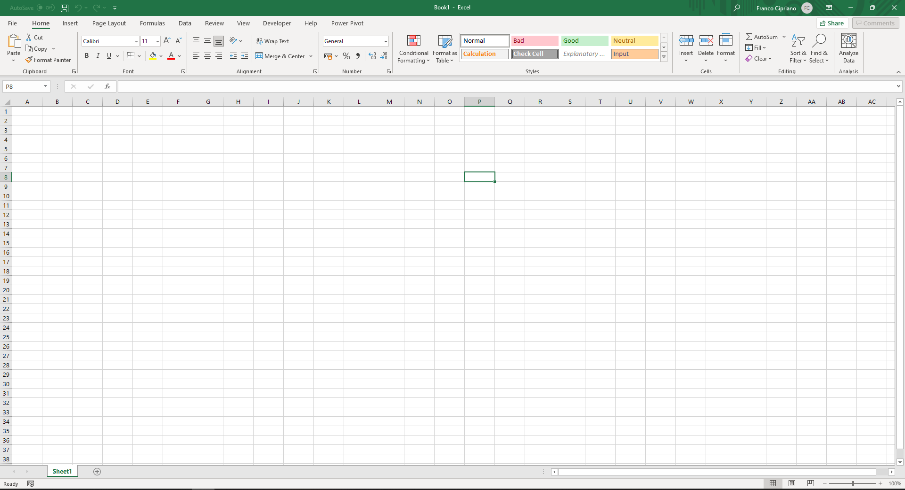
Familiarizing the layout
7
1
2
Ribbon
Tab List
Formula Bar
Column Letter
Row Number
Cell name
Quick Access Toolbar
Sheets tab
Page view buttons
Workspace
6
3
4
5
10
8
9
Notes:
MS excel uses a metro design. This provides a simpler design which gives a better user experience.

Slide 6
Preparing Your Data
Create the data file
Clean the data
Process the data
Perform Data Analysis and BI
Documentation

Slide 7


What is a dataset?
It is a set of data organized in a structure or logical order.
The structure is determined by the data set organization, it can be sequential or partitioned.

Slide 8



Challenges in Cleaning Your Data
Lack of an easy, sensible, and common process.
Users do not document their dataset effectively.
Unstructured and denormalized data

Slide 9
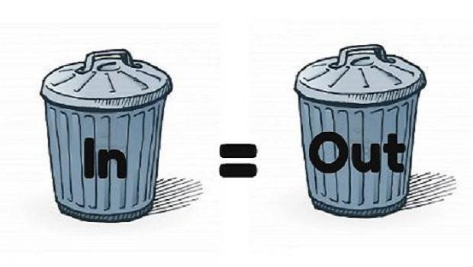
Don’t be a victim of GIGO

Slide 10

Create the Data File

Slide 11


Where to get your data?
Data Entry (Manual)
Import from other source

Slide 12
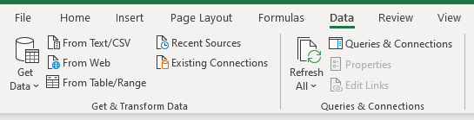
Importing from other source
Allows you to import data from other source outside MS Excel
Allows you to create Queries using Power Query. You can import or connect to external data, and then shape that data, for example remove a column, change a data type, or merge tables, in ways that meet your needs.
Notes:
Demo importing files using Power Query

Slide 13
Using the Query Editor
The Query Editor window runs the PowerQuery allows you to perform 4 different phases:
Connect – Make connections to data in the cloud, on a service, or locally
Transform – Shape data to meet your needs, while the original source remains unchanged
Combine – Integrate data from multiple sources to get a unique view into the data
Load – Complete your query and load it into a worksheet or Data Model and periodically refresh it.

Slide 14

Tips when doing data entry
Arrange your data in a tabular form
Reserve row for headers/row heading
Use column titles
If your table requires a title, put the title in the row above the column headings

Slide 15
Using Reference and Lookup Function
Function | Operation
VLOOKUP | Looks for a value in the leftmost column of a table, and then returns a value in the same row from a column you specify.
HLOOKUP | Looks for a value in the top row of a table or array of values and returns the value in the same column from a row you specify.
INDEX | Returns a value or reference of the cell at the intersection of a particular row and column, in a given range.
LOOKUP | Looks up a value either from a one-row or one-column range or from an array.
INDIRECT | Returns the reference specified by a text string
Notes:
Demo Index Match
Demo Indirect

Slide 16
INDEX + MATCH
INDEX - returns a cell reference at the intersection of the row number and the column number specified in the arguments from a given search range.
  =INDEX(search range, row number, [column number])
MATCH - Used to return the position of a search value.
  =MATCH(search value, search range, [match type])

Slide 17

PRACTICE EXERCISE

Slide 18

Clean Your Data

Slide 19
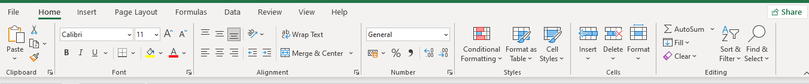
Formatting Cells

Slide 20
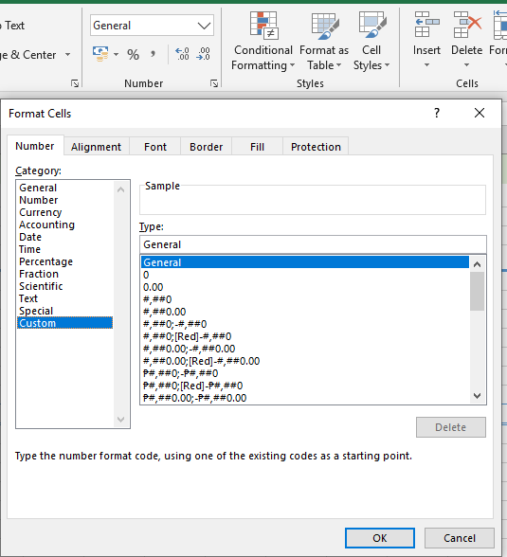
Using the Number Format
This allows you to format a cell by selecting from pre-defined options.
Select from different categories for you to select the format.

Slide 21
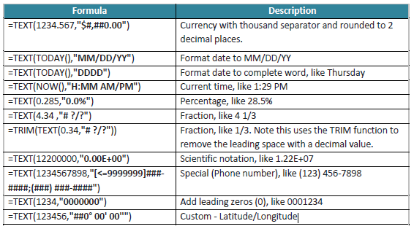
Format using TEXT()
TEXT(value,format_code)

Slide 22
Quick Check
What is the formula to get the current date and time, and format it like the example: “October 09,2023 10:05 PM”
=TEXT(NOW(),"MMMM DD,YYYY HH:MM AM/PM")

Slide 23
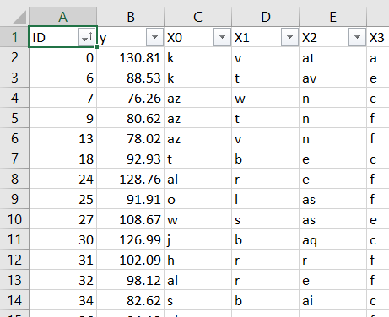
Data Indexing
An index is a unique identifier for your data.
This will allow you to restore the original arrangement of the rows.
Using MS Excel Fill Series you can create an index
Notes:
Demo how indexing is used

Slide 24
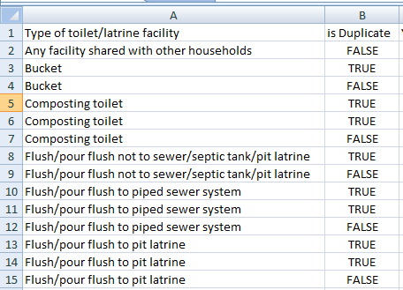
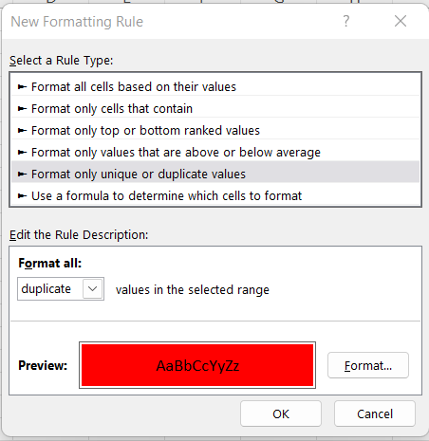

Identifying Duplicate Values
EXACT(text1,text2)
Remove duplicates function
Conditional Formatting
When using EXACT function make sure to sort the values of the column you want to check.
Notes:
Using EXACT Function
Using Remove duplicates function
Using Conditional Formatting

Slide 25
Parsing Text
Function | Operation
REPLACE | Replaces part of the string with a different string
SUBSTITUTE | Replace an existing text with a new text
CONCATENATE | Joins several texts
SEARCH | Returns the number of characters a specific character or string is found. Search is being done from left to right (not case-sensitive).
FIND | Returns the starting position of a string within another search string (case-sensitive).
TRIM | Removes the trailing spaces in a string
LEN | Return the number of characters in a string
Notes:
Text functions are used to manipulate text values.

Slide 26
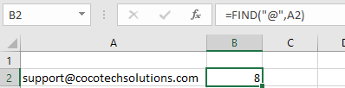
FIND vs SEARCH
FIND – It is used to check if a text is found inside another text and returns the position where the searched-for text begins.
  Is case sensitive
  Does not support wildcard
  start_num is optional and defaults to 1.
  It returns 1 when find_text is empty.
  It will return #VALUE error message if find_text is not found in within_text.

Slide 27
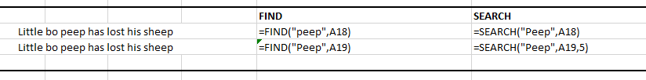
FIND vs SEARCH contd.
SEARCH - used to check if a text is found inside another text. If the search is successful, it returns the position where the searched-for text begins.
  Is NOT case sensitive
  =SEARCH(text to find, where to find, [starting from])

Slide 28
Wild card
Wildcard | Meaning
? | Single character wildcard
* | Wildcard string of undefined length
~ | Used when you want to use one of the wildcard characters as an actual criteria (e.g. a question mark is actually part of the text) Example: "What~?"

Slide 29
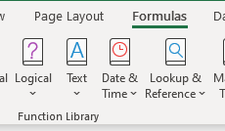
MORE TEXT Functions
There are still more STRING functions in EXCEL. You can find them under TEXT in the formula tab

Slide 30
PRACTICE EXERCISE

Slide 31
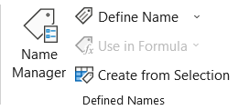
Name Range and Tables
Named Range – the name you assign to a group of cell
Table – A group of cell that consist of headers and rows. It allows you to easily sort, filter, and format data in a sheet.

Slide 32
Why use Name Range or Tables?
Names are easier to remember than range coordinates.
Names don’t change when you move a range to another part of the worksheet.
Named ranges adjust automatically whenever you insert or delete rows or columns within the range.
Names make it easier to navigate a worksheet. You can use the Go To command to jump to a named range quickly.
You can use worksheet labels to create range names quickly.
Makes your formula intuitive and easy to read.

Slide 33
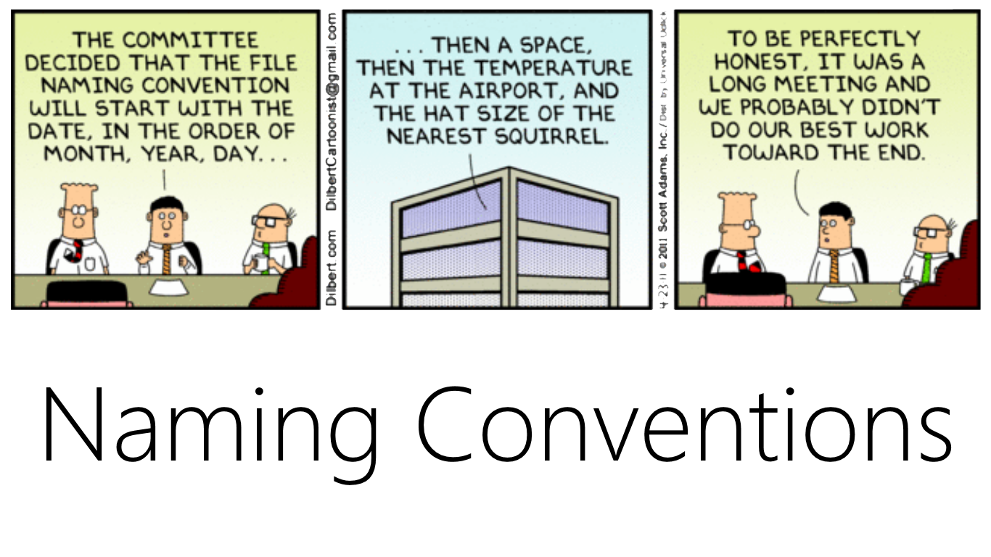
Things To Remember When Naming
The name can be a maximum of 255 characters.
The name must begin with either a letter or the underscore character (_).
Don’t use cell addresses (such as Q1) or any of the operator symbols
Range names that begin with R or C followed by one or more numbers are not allowed.
Try to keep names as short as possible while still keeping them meaningful.
Don’t use any of the built-in names in Excel

Slide 34
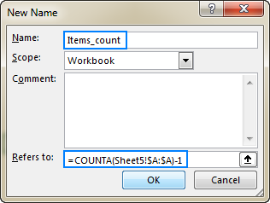
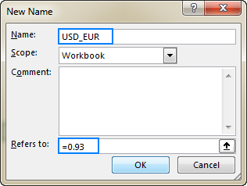
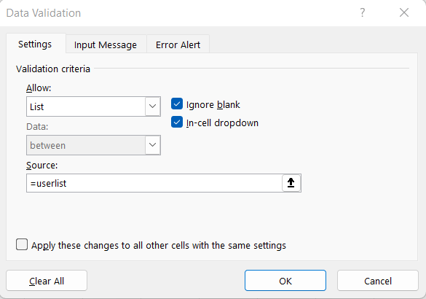
Where can you use Name Range?
Named Formula
Constant Values
Formula Reference
Data Validation

Slide 35
10 useful features of Tables
Integrated Sorting and Filtering
Column headings are visible while scrolling
Easier Formatting
Automatic Table expansion when new data is added
Quick Totals
Calculated Columns
Structured References
One-click data reference
Dynamic Charts
Printing only the table

Slide 36
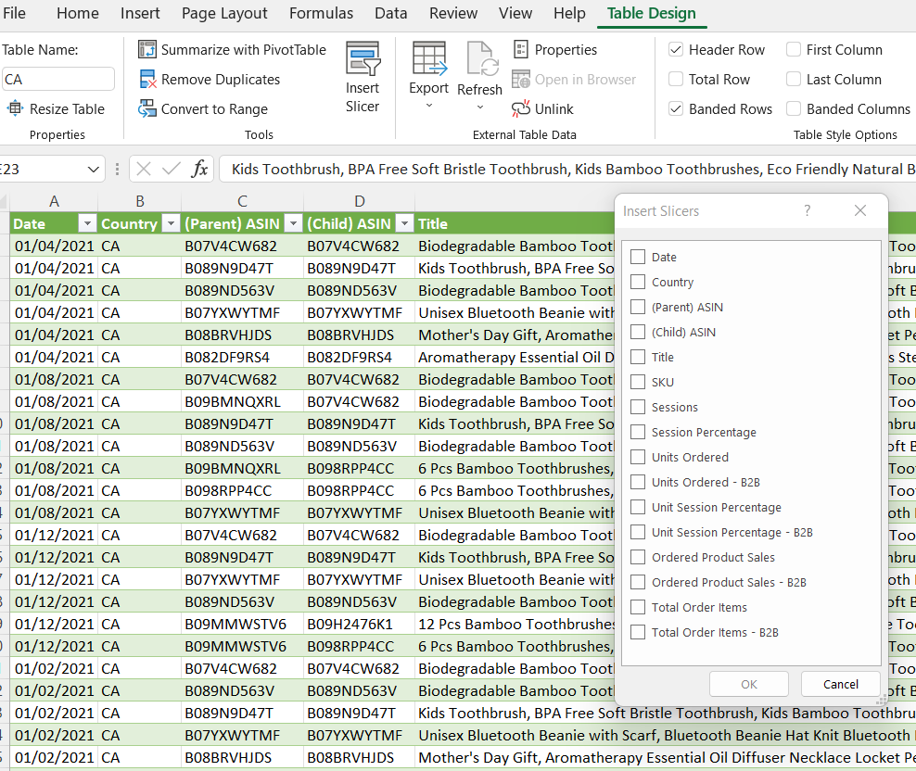
Using Slicers in Table
Slicers provide buttons that you can click to filter tables, or PivotTables.

Slide 37
PRACTICE EXERCISE

Slide 38

Process Your Data

Slide 39
Tracing Formula Errors
The formula-auditing features operate by creating tracers—arrows that literally point out the cells involved in a formula.
Notes:
Formula Tracing is best when troubleshooting an Error that is caused by:
1. Wrong Cell Reference
2. Flawed Data

Slide 40
Text functions to extract values
Function | Operation
LEFT | Returns number of characters starting from the left.
RIGHT | Returns number of characters starting from the right.
SUBSTITUTE | Replace an existing text with a new text
LEFT(text,[num_chars])
RIGHT(text,[num_chars])
SUBSTITUTE(text, old_text, new_text, [instance_num])

Slide 41
Get to know your errors
What I see | What it means
#DIV/0! | When you’re trying to divide by 0
#NAME? | When text in a formula is not recognized
#NULL! | When a space was used instead of a comma in formulas that reference multiple ranges; a comma is necessary to separate range references
#VALUE! | When the wrong type of operand or function argument is used
#N/A | When a formula or a function inside a formula cannot find the referenced data
#REF! | Invalid cell reference

Slide 42
Replacing Error Values
IFERROR – Lets you specify a value if an expression is an error
IFERROR(value, value_if_error)
=IFERROR(VLOOKUP(….), “VALUE TO DISPLAY”)
ISERROR – returns TRUE is expression has no error and FALSE if error
ISERROR(value)
=IF(ISERROR(VLOOKUP(…), “TRUE VALUE”, VLOOKUP(…))
Notes:
IFERROR = Lets you specify a value if an expression is an error
ISERROR = returns TRUE is expression has no error and FALSE if error

Slide 43
Deriving Values From Formulas
Derived Values are values that are acquired through calculation and is not part of your original data.
Aggregate Functions allows you to group values or multiple rows to get a single summary result.

Slide 44

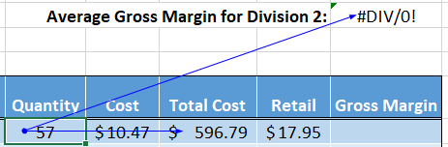
Precedents vs. Dependents
Precedents – These are cells that are directly or indirectly referenced in a formula.
Dependents – These are cells that are directly or indirectly referenced by a formula in another cell.

Slide 45
More Ways Of Troubleshooting
Show Formula
Error Checking
Evaluate Formulas
Notes:
Show Formula - This allows you to see which cells contains a formula
Error Checking – It determines the correctness of your formula. It operates in the background to monitor your formulas
Evaluate Formula – This allows you to evaluate the content of a formula one-by-one

Slide 46
AGGREGATE Function
This is a new function available for Excel 2019 and Office 365
This can apply different aggregate functions to a list with the option to ignore hidden rows and error values.
AGGREGATE(function_num, options, ref1, [ref2], …)
function_num – Specify which aggregate function to use, 1 to 19
Options – determines which values to ignore in the evaluation range.
Ref1 – First numeric argument. This can be the range of values you want to get the result.
Ref2 – an optional value that is required by Ref1. Certain functions require second argument e.g. LARGE(), SMALL()

Slide 47
AGGREGATE Parameters
Function_num | Function
1 | AVERAGE
2 | COUNT
3 | COUNTA
4 | MAX
5 | MIN
6 | PRODUCT
7 | STDEV.S
8 | STDEV.P
9 | SUM
10 | VAR.S
11 | VAR.P
12 | MEDIAN
13 | MODE.SNGL
14 | LARGE
15 | SMALL
16 | PERCENTILE.INC
17 | QUARTILE.INC
18 | PERCENTILE.EXC
19 | QUARTILE.EXC
Option | Behavior
0 or omitted | Ignore nested SUBTOTAL and AGGREGATE functions
1 | Ignore hidden rows, nested SUBTOTAL and AGGREGATE functions
2 | Ignore error values, nested SUBTOTAL and AGGREGATE functions
3 | Ignore hidden rows, error values, nested SUBTOTAL and AGGREGATE functions
4 | Ignore nothing
5 | Ignore hidden rows
6 | Ignore error values
7 | Ignore hidden rows and error values

Slide 48
SUMPRODUCT
Can help you compute weighted average using just the SUMPRODUCT formula.
SUMPRODUCT function can be used when you want to first multiply two or more sets to arrays and then get its sum.

Slide 49
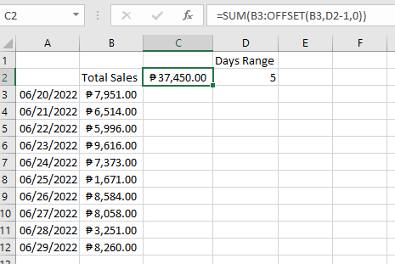
Using OFFSET
Combining OFFSET function with your aggregate functions will allow you to select the range that needs to be calculated in a more dynamic way

Slide 50
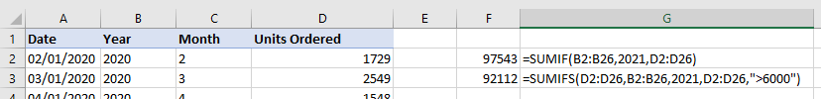
Aggregate function with condition
SUMIF, SUMIFS, COUNTIF, COUNTIFS, AVERAGEIF, AVERAGEIFS
Allows you to perform aggregate operation with at least 1 condition

Slide 51
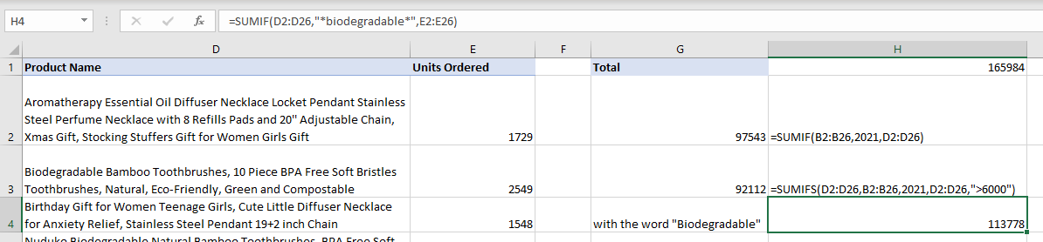
Using wildcards in aggregate function

Slide 52

INDIRECT Function
INDIRECT
+
DATA VALIDATION

Slide 53
PRACTICE EXERCISE

